Slide 1
When the Developer Must Design
Andrew Malek
@malekontheweb

Slide 2
Programmers Here…
AbstractSingletonProxyFactoryBean
SimpleBeanFactoryAwareAspectInstanceFactory
ListViewVirtualItemsSelectionRangeChangedEventHandler
IDataGridColumnStyleEditingNotificationService
$test =~ s/(\b\w+\b)(?:\s*\1)+/$1/g;
http://www.perlmonks.org/bare/?node_id=104565

Slide 3

UX
Fonts
Negative Space
Icons
Dialog
Boxes
RGB

Slide 4
Andrew Malek
UI / UX Developer
NCR Corporation, Retail Solutions Division
@malekontheweb
http://malekontheweb.com/

Slide 5
A Vital Truth About Design
“Nobody Wants To Use Your Product”
- Goran Peuc, Principal UX Designer at SAP Dublin
https://www.smashingmagazine.com/2016/01/nobody-wants-use-your-product/

Slide 6
“[P]eople are more interested in the end result and in obtaining that result in the quickest, least intrusive and most efficient manner possible.”
https://www.smashingmagazine.com/2016/01/nobody-wants-use-your-product/

Slide 7
“The Better the Design, the More Invisible It Becomes”
- Jared M. Spool, usability guru
https://articles.uie.com/experiencedesign/
“Good design is pretty much invisible.”
- Carrie Cousins, chief writer, Design Shack
http://designshack.net/articles/graphics/10-reasons-why-the-best-design-is-invisible/

Slide 8
Topics
Interface Consistency
Whitespace (Negative Space) and Simplicity
Dialogs and Error Messages
Propper Grammer and Speling
Icons
Perceived Performance
Proper Grammar and Spelling

Slide 9
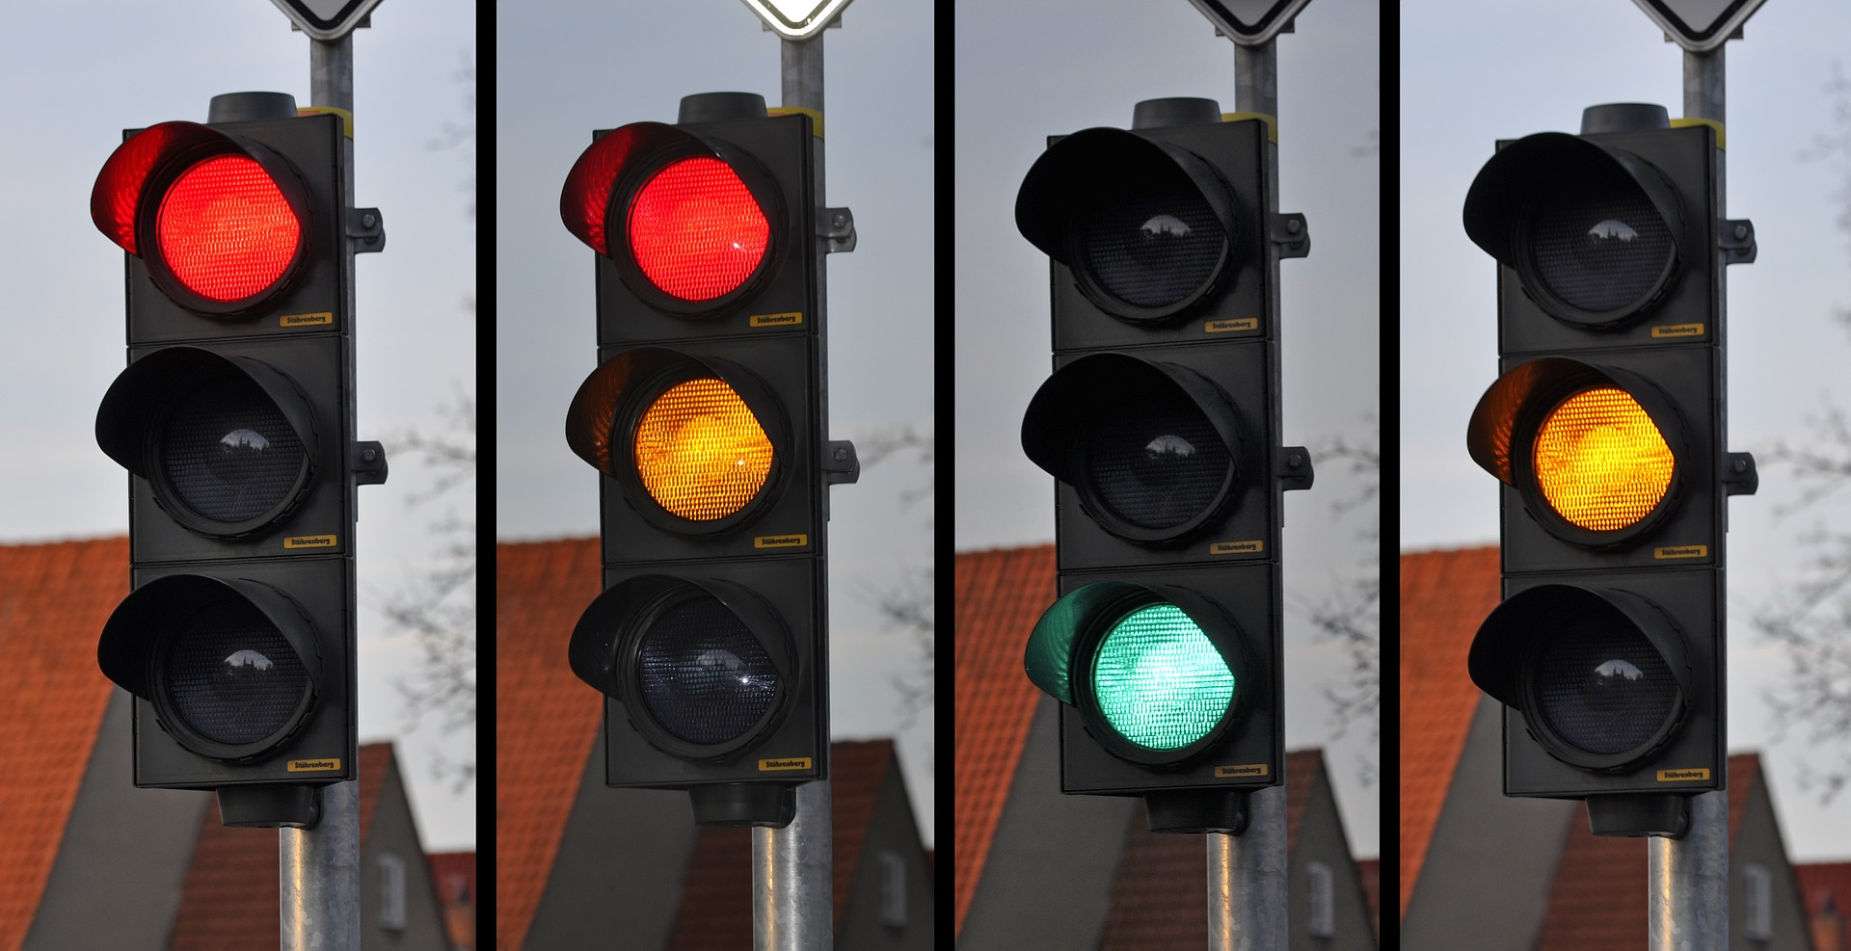
Consistency

Slide 11
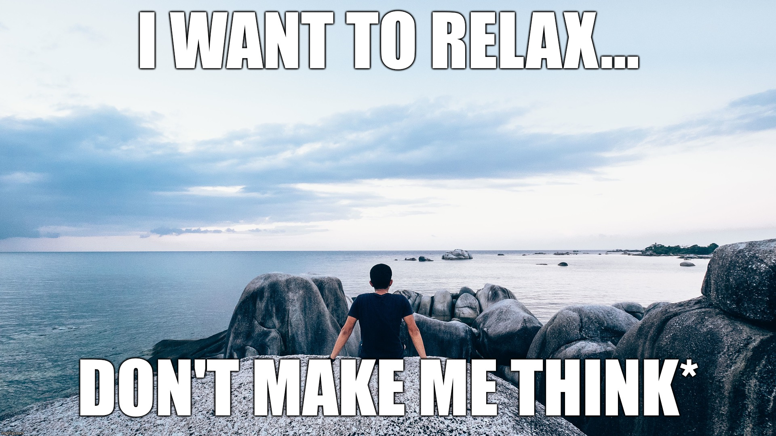
“Don’t Make me Think” – also the name of a web UX book by Steve Krug

Slide 12

Spatial Memory

Slide 13
“In human-computer interfaces, knowledge of the spatial location of controls can enable a user to interact fluidly and efficiently, without needing to perform slow visual search.”
- J. Scarr, A. Cockburn, C. Gutwin
http://www.joey.scarr.co.nz/pdf/spatialreview.pdf

Slide 14
“People don’t like to learn things. If they take the time to learn something, they expect to be able to apply that knowledge in many places. It follows that good designers conserve the number of things users need to learn to get stuff done.”
Scott Berkun, author and speaker
http://scottberkun.com/essays/5-how-to-avoid-foolish-consistency/

Slide 15
UI Guidelines
iOS Human Interface Guidelines https://developer.apple.com/design/ (follow the link)
Google Material Design (used in Android) http://design.google.com/spec/
Design applications for the Windows desktop https://dev.windows.com/en-us/desktop/design
OS X Human Interface Guidelines https://developer.apple.com/design/ (follow the link)

Slide 16
“When you mess with mental models, … you run a major risk of slowing down and annoying your customers, and potentially losing them all together.”
Liraz Margalit, Web Psychologist
https://uxmag.com/articles/who-moved-my-virtual-cheese

Slide 17
“Nothing irritates a user more quickly than moving or disappearing navigational elements.”
Patrix Cox, User Researcher and Product Designer
http://designshack.net/articles/graphics/maintaining-consistency-in-your-ui-design/

Slide 18
“… we inferred the location of the icon is more important than the visual imagery. People remember where things are, not what they look like.”
Jared M. Spool, usability guru
https://www.uie.com/brainsparks/2006/02/20/orbitz-cant-get-a-date/

Slide 19
“Keep in mind though that apps and users are different: one solution might work … well in an app and fail in yours. It’s not a one-size-fits-all thing.”
Zoltan Kollin, UX Director Ustream
https://medium.com/@kollinz/misused-mobile-ux-patterns-84d2b6930570

Slide 20
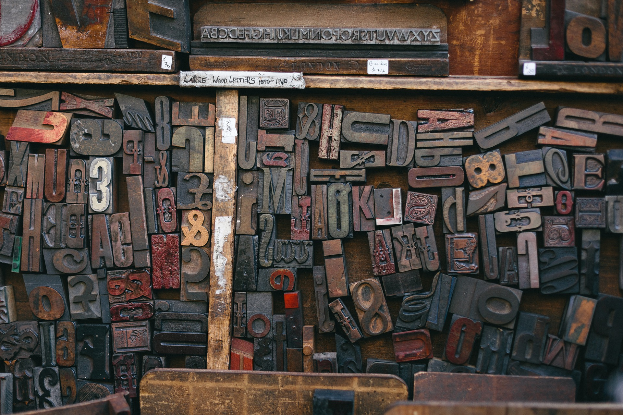
Fonts

Slide 21
“A good principle to live by, whether you’re new to typography or a seasoned pro, is to keep it simple. Or to put it another way, don’t use too many fonts. … [M]ixing too many fonts on a page will probably result in a confused message”
Nigel French
http://create.adobe.com/2013/12/1/eight_tips_for_combining_typefaces.html

Slide 22
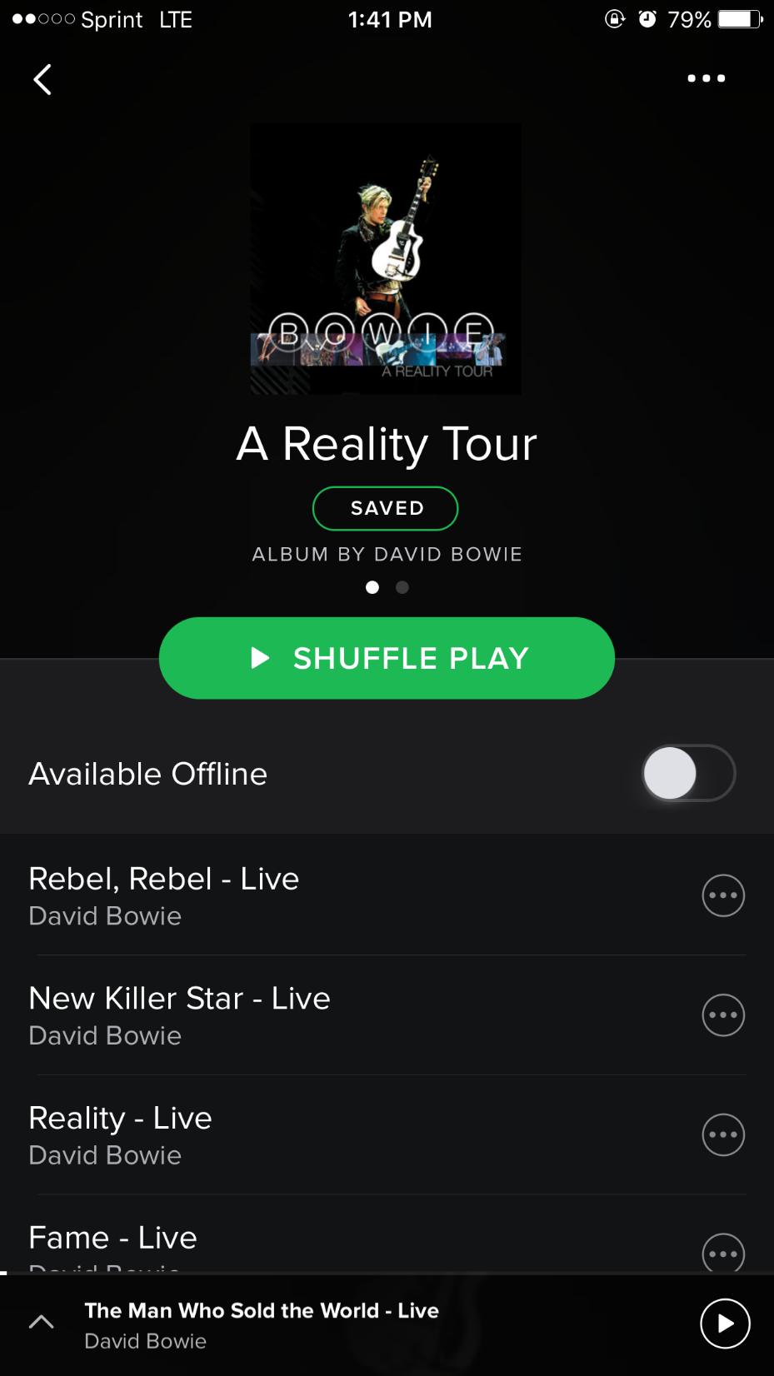

Slide 23
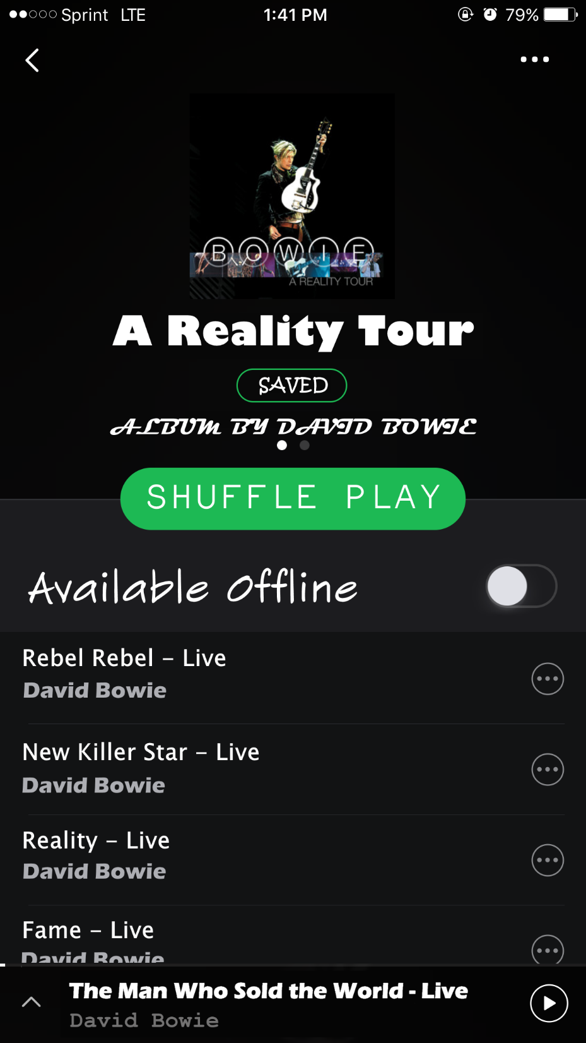

Slide 24

1 Ill ocean (Bauhaus 93)
1 Ill ocean (Rockwell)
(Gill Sans® Monotype)
“5 Faces for UI Design” - Dan Eden
http://typecast.com/blog/type-on-screen-5-faces-for-ui-design

Slide 25
“Type that is too small can be hard on the eyes and can even cause a headache.”
National Institute on Aging, U.S. Department of Human Services
https://www.nia.nih.gov/health/publication/making-your-printed-health-materials-senior-friendly

Slide 26
“Text must be the proper size for readability from desired distances, and must contrast clearly against the background.”
Paul Nini, Professor at The Ohio State University
http://www.aiga.org/typography-and-the-aging-eye/

Slide 27

Colors

Slide 28
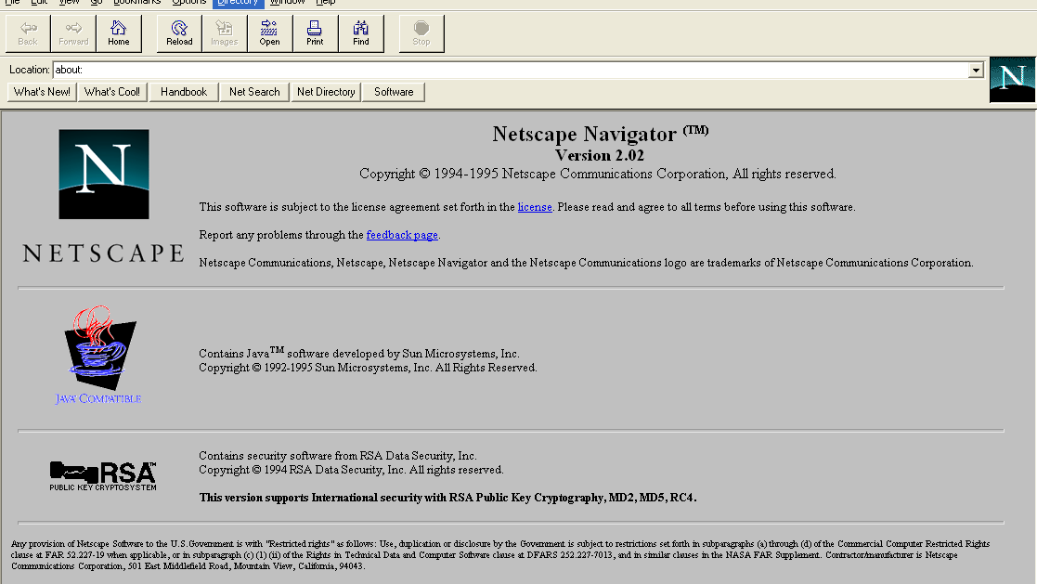

Slide 29
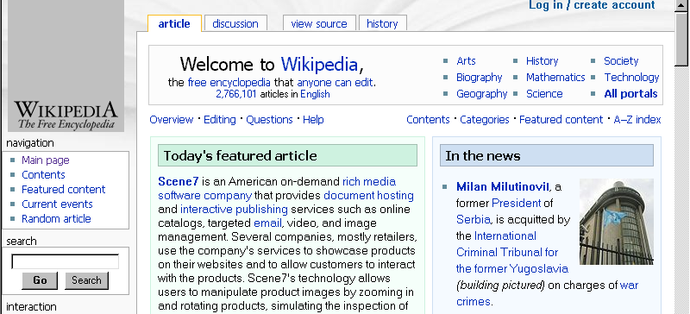
Screenshot from Microsoft Internet Explorer 5
Used with permission from Microsoft
https://en.wikipedia.org/wiki/File:Internet_Explorer_5_on_Windows_98.png

Slide 30
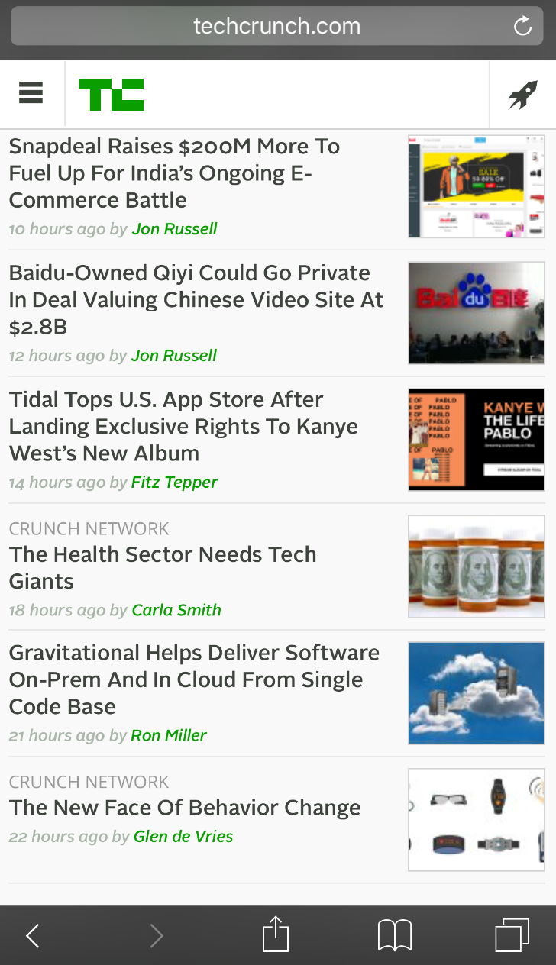
TechCrunch - screenshot taken on iOS Safari

Slide 31
“Avoid using the same color in both interactive and noninteractive elements. Color is one of the ways that a UI element indicates its interactivity. If interactive and noninteractive elements have the same color, it’s harder for users to know where to tap.“
iOS Human Interface Guidelines

Slide 32
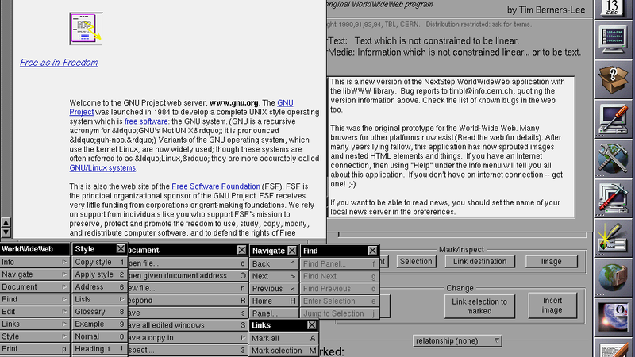

Slide 33
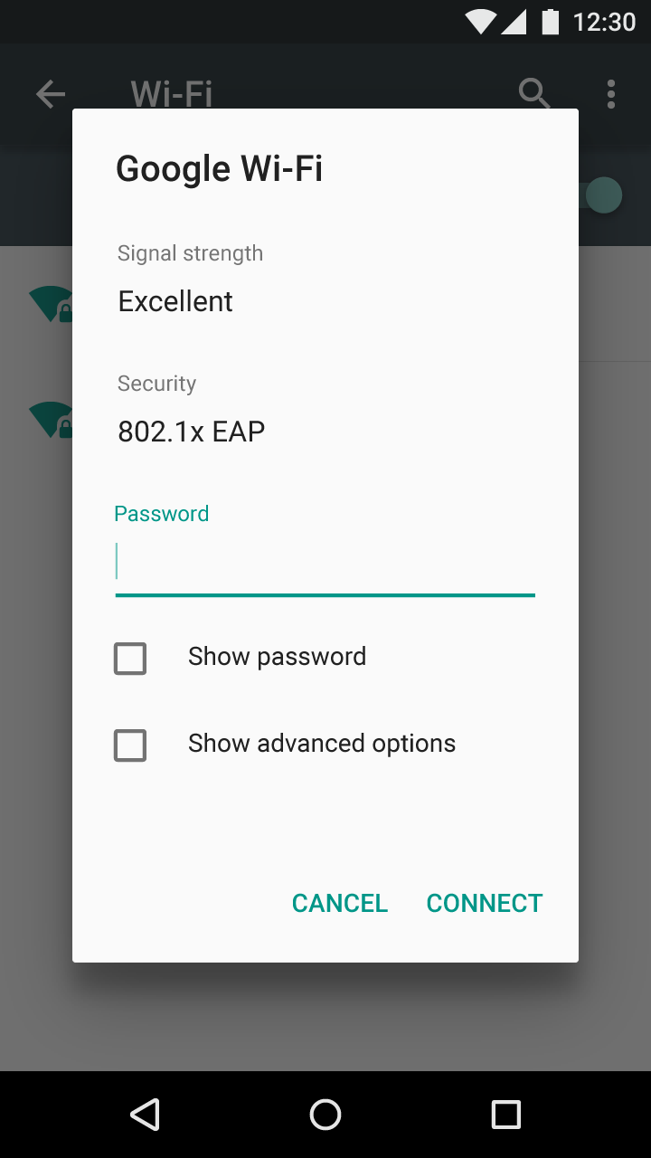

Slide 34
“Flat designs must rely on color & contrast as the indicator of interaction in the interface. That’s not an easy task.”
Marcin Treder, UXPin CIO
https://studio.uxpin.com/blog/5-dangers-of-flat-design/

Slide 35
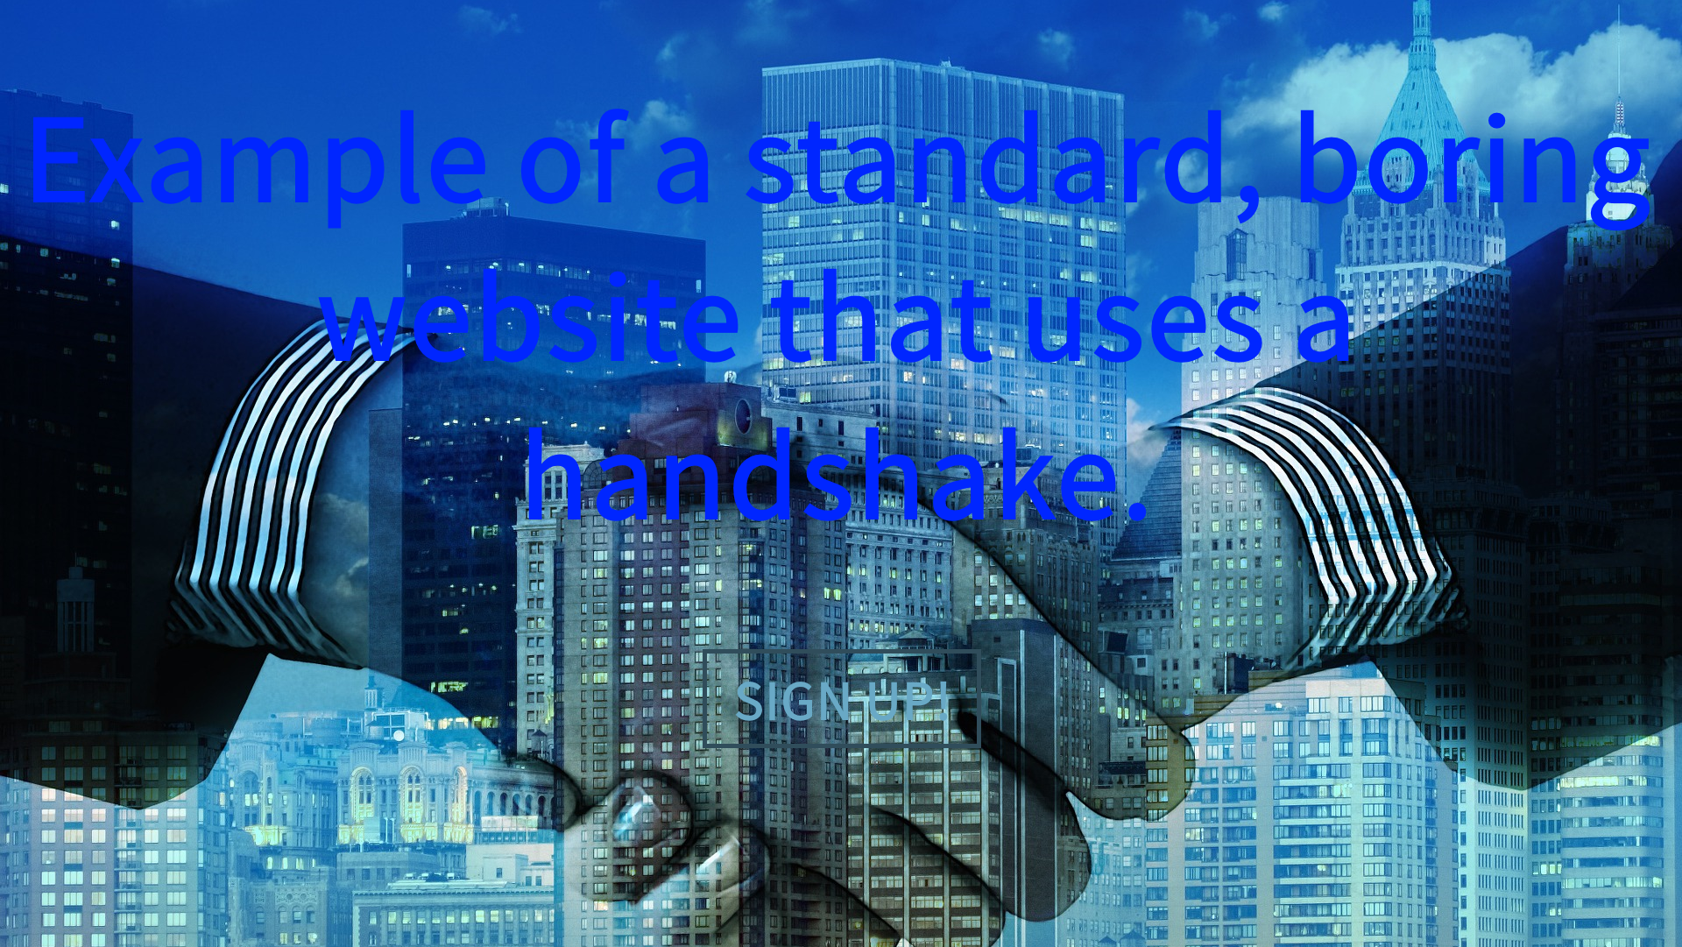

Slide 36
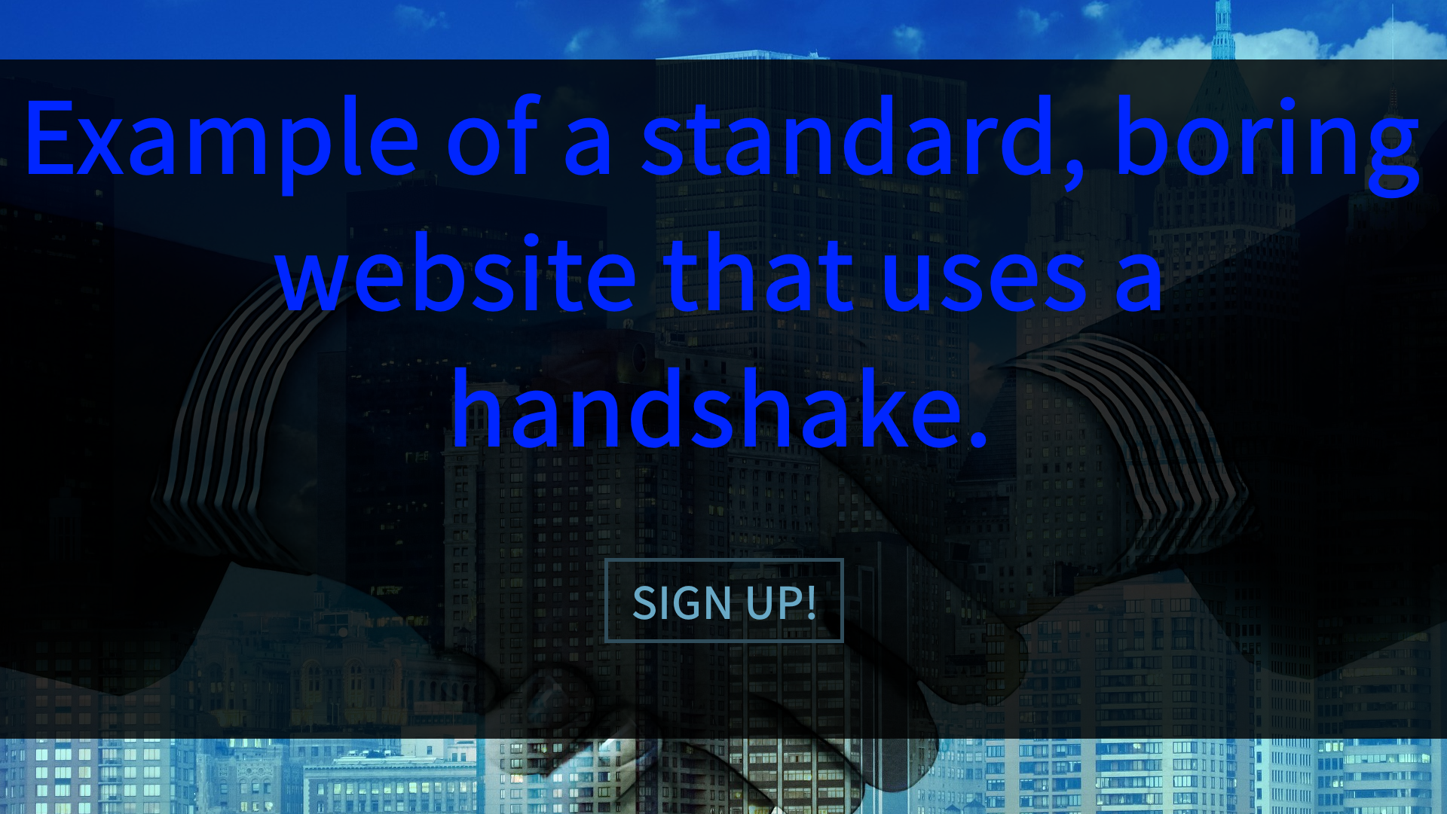

Slide 37
Color Contrast
WebAIM Color Contrast Checker http://webaim.org/resources/contrastchecker/
Check my Colours http://www.checkmycolours.com/
Color Safe – Create accessible color palettes http://colorsafe.co/
“Color Contrast for Better Readability” - Tom Osborne, Viget VP of Design https://viget.com/inspire/color-contrast

Slide 38
Simulate Colorblindness
Coblis – Color Blindness Simulator http://www.color-blindness.com/coblis-color-blindness-simulator/
Color Blindness Simulator http://www.etre.com/tools/colourblindsimulator/
iOS App Store: Chromatic Vision Simulator http://asada.tukusi.ne.jp/cvsimulator/e/

Slide 39
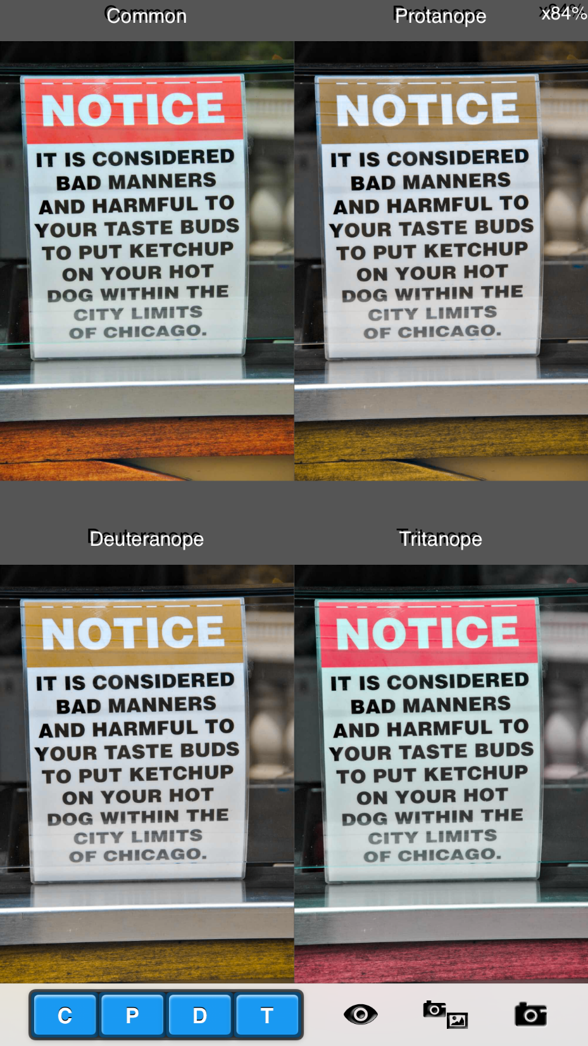

Slide 40

Whitespace

Slide 41
"Out of clutter, find simplicity.“ - Albert Einstein
"The best way to find out what we really need is to get rid of what we don’t.“ - Marie Kondo, author and organizing consultant
“If your UI even vaguely resembles an airplane cockpit, you’re doing it wrong.” - John Gruber, Markdown inventor and writer http://daringfireball.net/linked/2008/12/01/fahey-bulk-rename-utility

Slide 42
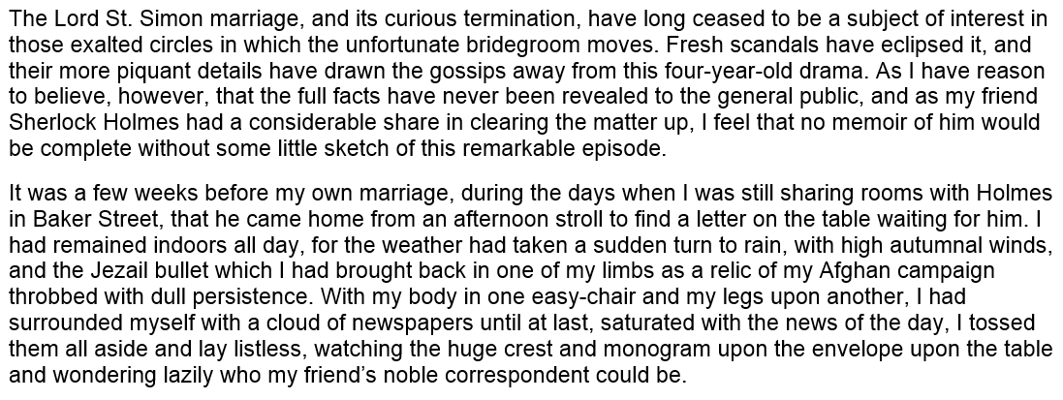

Slide 43
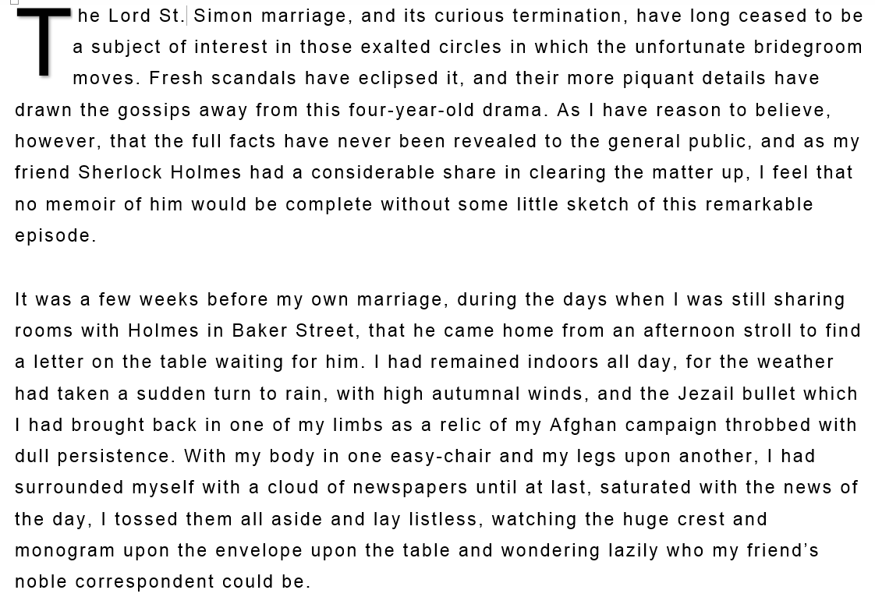

Slide 44
“Poor use of white space does not impact reading performance. Higher satisfaction and preference of the better layout, should not be discounted, however, since such variables influence whether a user continues interacting with a website or simply moves on to one with better visual appeal.”
http://usabilitynews.org/reading-online-text-with-a-poor-layout-is-performance-worse/

Slide 45
Whitespace can “break up various parts of content for easier absorption of information.”
Marc Schenker, writer
http://www.webdesignerdepot.com/2014/07/how-to-make-whitespace-work-on-the-web/

Slide 46
“Whitespace is essential for providing spatial relationships between visual items, and actually guides your eye from one point to another. Whitespace doesn't have to be large. Just a generous "gutter" between text and pictures can make a big difference…”
Carla Rose, photographer and writer
http://www.informit.com/articles/article.aspx?p=174346&seqNum=3

Slide 47
“Make it easy for people to interact with content and controls by giving each interactive element ample spacing. Give tappable controls a hit target of about 44 x 44 points.”
- iOS Human Interface Guidelines

Slide 48
“To ensure balanced information density and usability, touch targets should be at least 48 x 48 dp. In most cases, there should be 8dp or more space between them.”
- Google Material Design guidelines

Slide 49
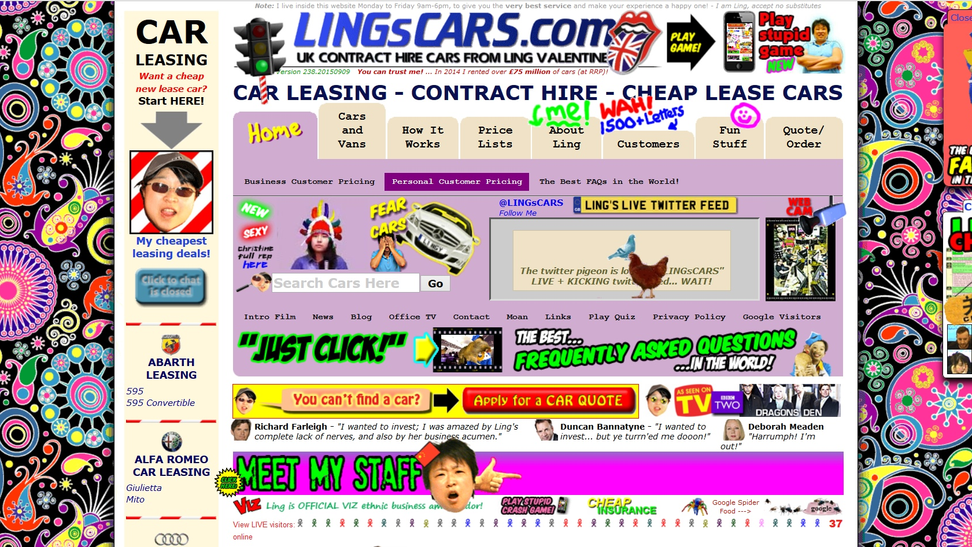

Slide 50
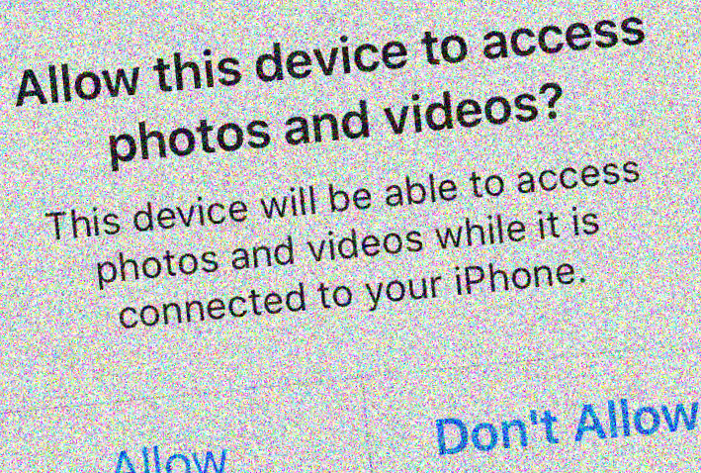
Dialogs and Errors

Slide 51
"Programming today is a race between software engineers striving to build bigger and better idiot-proof programs, and the Universe trying to produce bigger and better idiots. So far, the Universe is winning."
Rick Cook, author
https://en.wikiquote.org/wiki/Rick_Cook

Slide 52
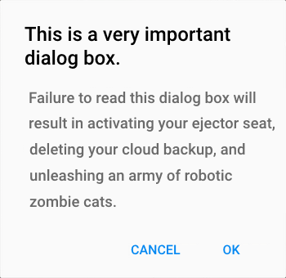
“You actually need to read the question.” – David Chisnall
http://www.informit.com/articles/article.aspx?p=1146301

Slide 53
Suggestions from iOS Guidelines
“Avoid creating unnecessary alerts”
“Succinctly describe the situation”
“Avoid single-word titles”
“Use verbs and verb phrases”

Slide 54
Discussions on Alerts
iOS Human Interface Guidelines – Alert https://developer.apple.com/library/ios/documentation/UserExperience/Conceptual/MobileHIG/Alerts.html
“Should I use Yes/No or Ok/Cancel on my message box?” – UX Stack Exchange http://ux.stackexchange.com/questions/9946/

Slide 55
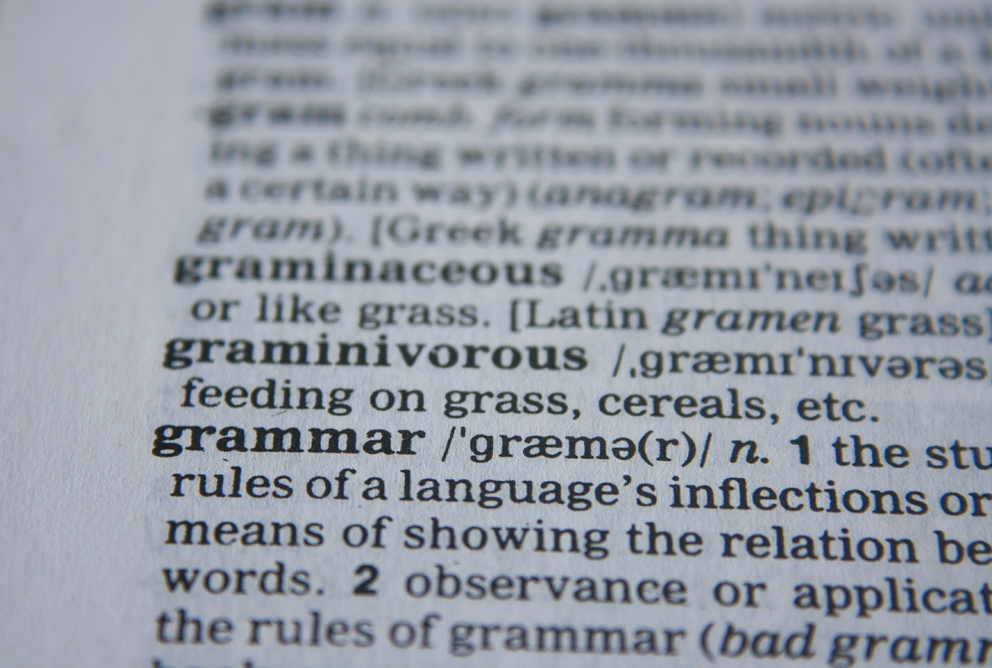
Grammar

Slide 56
Consistency
Title Case? Or sentence case?
End everything with punctuation – or don’t
Don’t use exclamation points unless really needed!!!!
Optional word spellings? Pick one. Login. Log in. Signup. Sign up.
You should keep the tone consistent, please.

Slide 57
Grammar and Microcopy
For Grammar’s Sake, Please Log In http://www.slideux.com/slideux/2014/11/14/log-in-vs-log-in
Does Bad Grammar Make Bad UX? http://www.sitepoint.com/bad-web-grammar-bad-ux/
Five Ways to Prevent Bad Microcopy https://www.smashingmagazine.com/2013/06/five-ways-prevent-bad-microcopy/
The Art of Writing Microcopy and Why it Matters http://www.smartinsights.com/persuasion-marketing/web-copywriting/the-art-of-writing-microcopy-and-why-it-matters/

Slide 58

Icons

Slide 59
Icons One Could Argue as “Standards”
 | Save
 | Search (or Zoom)
 | Help
 | Printout
 | Home Screen
 | Settings

Slide 60
“…I narrowed my results to the 131 people who selected the 18-25 age range.” “96% of respondents knew that the square icon with the notch cut out of the top right represented a floppy disk…”
Lis Pardi, Information Scientist
http://boxesandarrows.com/icon-survey-results/

Slide 61


Potentially Confusing Icons
 | Mailbox? In Every Country? http://www.curveagency.com/blog/usability-web-icons
 | Like? Bookmark? Favorite?
 | Learning? Intelligence? http://www.deseretnews.com/article/705370663/
 | Sign Out? Go Forward?

Slide 62
“The Microsoft Outlook toolbar is a good example: the former icon-only toolbar had poor usability and changing the icons and their positioning didn’t help much. What did help was the introduction of text labels next to the icons. It immediately fixed the usability issues and people started to use the toolbar.”
http://uxmyths.com/post/715009009/myth-icons-enhance-usability

Slide 63
“In our study, we found that for icons with labels, users were able to correctly predict what would happen when they tapped the icon 88% of the time.
For icons without labels, this number dropped to 60%.
And for unlabeled icons that are unique to the app, users correctly predicted what would happen when they tapped the icon only 34% of the time.”
Hannah Alvarez, UserTesting
https://www.usertesting.com/blog/2015/08/04/user-friendly-ui-icons/

Slide 64
“To help overcome the ambiguity that almost all icons face, a text label must be present alongside an icon to clarify its meaning in that particular context.”
“Use the 5-second rule: if it takes you more than 5 seconds to think of an appropriate icon for something, it is unlikely that an icon can effectively communicate that meaning.”
Aurora Bedford, User Experience Specialist
https://www.nngroup.com/articles/icon-usability/

Slide 65
Icon Libraries
FontAwesome https://fortawesome.github.io/Font-Awesome/
FlatIcon http://www.flaticon.com/
Bootstrap framework (Glyphicon Halflings) http://getbootstrap.com/

Slide 66

Perceived Performance

Slide 67
“As with so many things in life, perception is reality: if users see file copying as slower, it is slower.”
Jeff Atwood, Stack Overflow co-founder
http://blog.codinghorror.com/actual-performance-perceived-performance/

Slide 68
0.1 second | Instantaneous feedback
1.0 second | Noticeable delay
10 seconds | Patience reached limit
Response Times: The 3 Important Limits
Jakob Nielsen, Nielsen Norman Group
https://www.nngroup.com/articles/response-times-3-important-limits/

Slide 69
Please Wait…


Slide 70
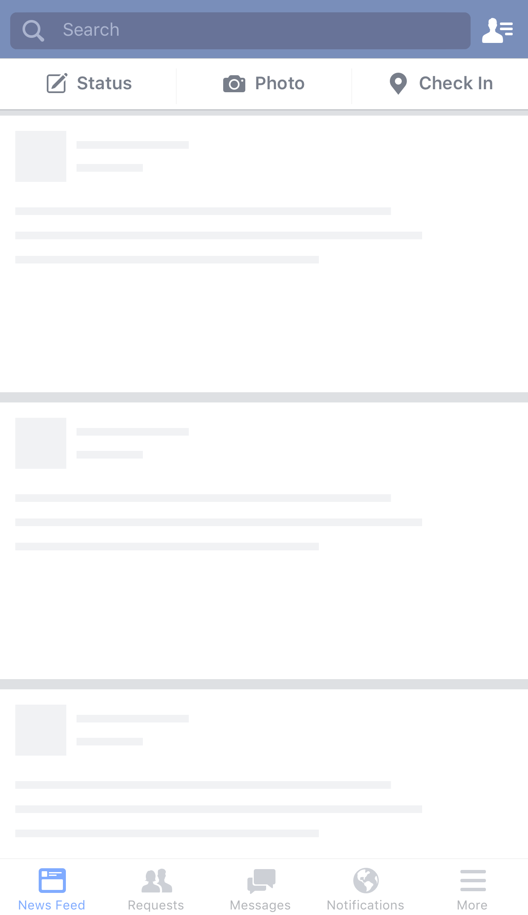

Slide 71

Design

Slide 72
Design Tips
Be consistent
Whitespace is your friend
Explain dialog boxes and errors
Double-check spelling and grammar
Label icons
Perceived performance is important

Slide 73
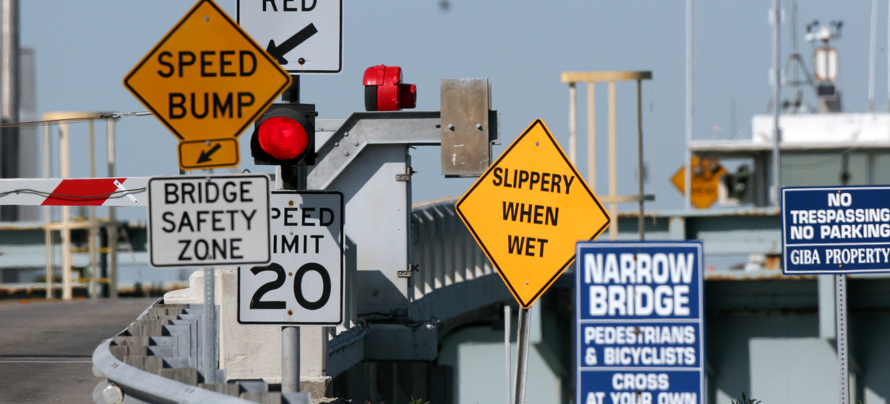
Dawn Huczek on Flickr - “I think they need a few more signs!”
https://creativecommons.org/licenses/by/2.0/

Slide 74

@malekontheweb

